Slide 1
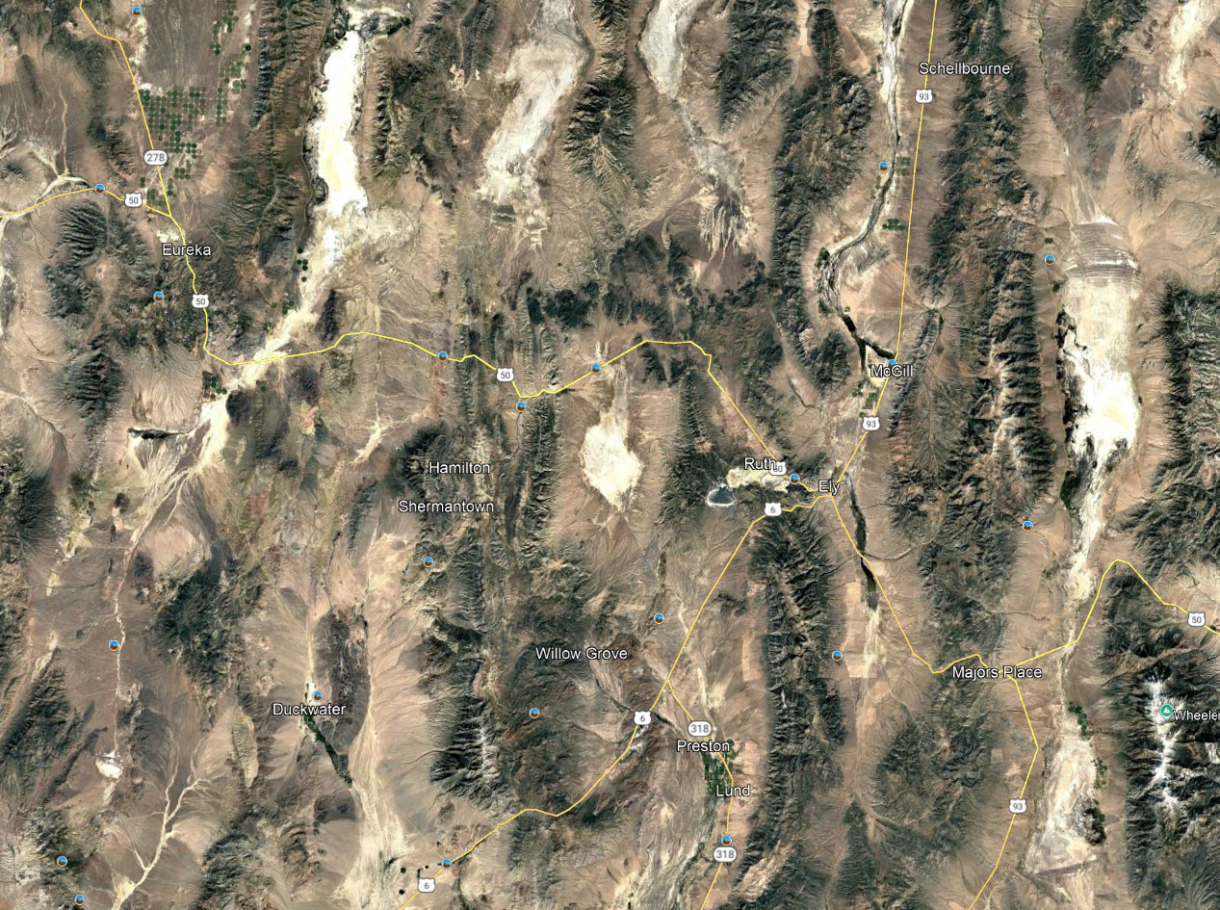
This study finds that the Robinson district was the site of extreme extension (400%) that occurred in a period less than 900,000 years

Slide 2
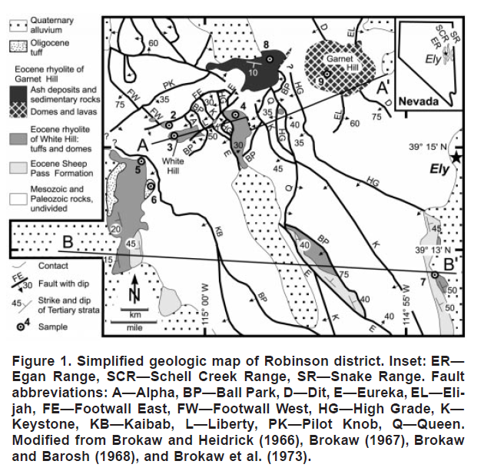
Geology Overview
Cretaceous monzonitic intrusions
Related to porphyry Cu-Au-Mo mineralization
Eocene Sheep Pass Formation
Lacustrine facies with fossils dating to the Eocene
Eocene Rhyolites (37.6 to 36.68 Ma)
Oligocene ignimbrite (28.43 Ma)

Slide 3
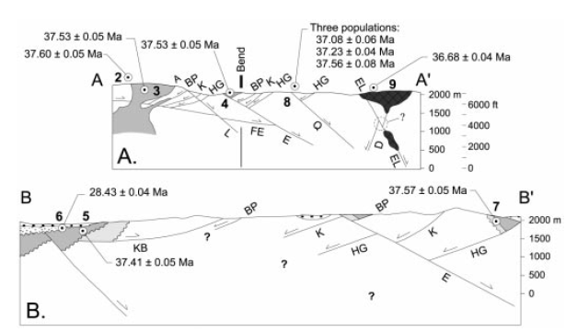
Structure Overview
Some minor Cretaceous faults that channeled mineralizing fluids
Abundant faults from the Eocene
Earlier west-dipping faults
Later east-dipping faults
The district straddles a tilt “antiform” (extensional accommodation zone)
Rocks on the western side are tilted to the west (similar to the Egan range to the north)
Rocks on the eastern side are tilted to the east (similar to the Egan range to the south)
Structural reconstructions suggest 400% extension

Slide 4
Structure Overview
Fault Order:
Early west-dipping faults (BP, K, HG)
Shallowly-dipping east dipping faults (FE)
Moderately-dipping, east-dipping faults (Q and E)
Southeast dipping faults (L)

Slide 5
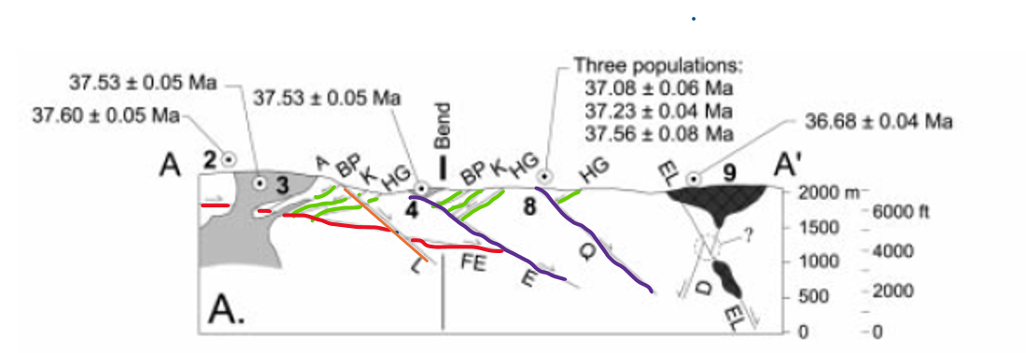
The Beginning: Rhyolite of White Hill
Interpreted as marking the beginning of extension
Rhyolitic domes, dikes, and tuffs
Four dates range from 37.41 to 37.60 Ma (Sample 2,3,4, and 7)
Intrude early west-dipping faults (HG, K, and BP) and early-stage east-dipping faults (FE)
Despite these cutting early faults, their related eruptive products are tilted to a similar magnitude as older rocks.
One date at 37.41 Ma(Sample 5)
Slight angular unconformity

Slide 6
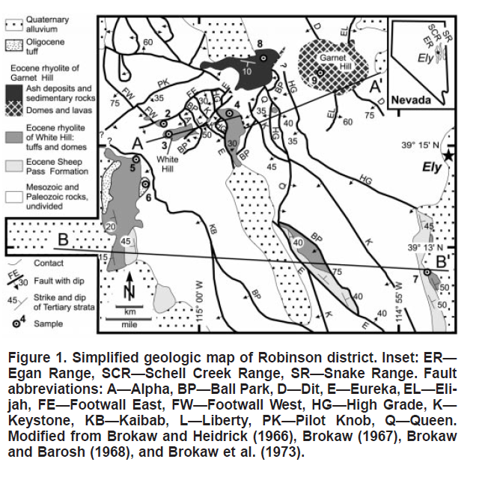
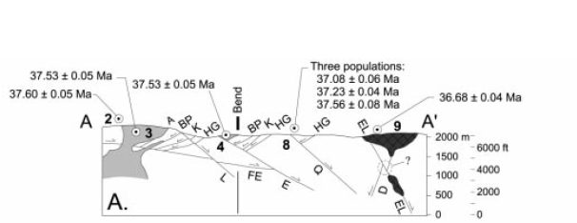
The End: Rhyolite of Garnet Hill
Rhyolitic dikes, tuffs, and shallow intrusives
K-Ar age dates range from 36.68 to 37.56 Ma (Samples 8 and 9)
Evidence supporting that this phase is younger than the major extensional episode:
The Garnet Hill complex has a circular outline and it cuts normal faults.
Generally have 10 degree dips
The tuffaceous rocks overlie older tilted rocks in angular unconformity
Mantle some of the older faults
Only cut by small-offset faults

Slide 7
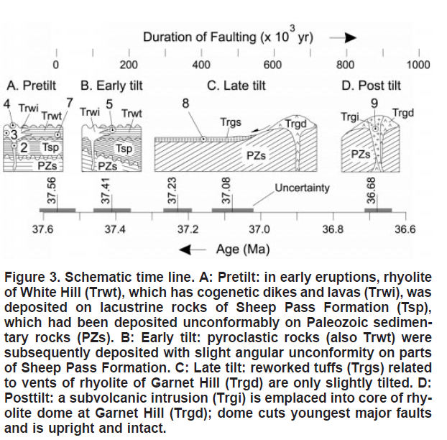
Putting it Together
The rhyolitic rocks of White Hill (~37.56 Ma) were erupted and intruded during the onset of extension
Extension and tilting couldn’t have started earlier because pyroclastic rocks were deposited over the lacustrine Sheep Pass Formation and are tilted to a similar magnitude (Sample 4 and 7).
One effusive eruption around 37.41 is in slight angular unconformity with the Sheep Pass Formation suggesting extension had begun (Sample 5)
The un-faulted rhyolites of Garnet Hill bracket the end of extension.
One early Garnet Hill epiclastic(Sample 8) is slightly tilted
The intrusion of the Garnet Hill dome occurred when extension and tilting was completed
400% Extension Age Ranges:
Maximum span between 37.56 to 36.68 Ma (~900k years)
Minimum span between 37.41 to 37.08 Ma (~330k years)
Interpreted to be between 37.56 and 37.08 Ma (~480k years)

Slide 8
Is 400% extension in <900k years rare?
Length of Robinson area at starting point
No
Yerington (0.7 to 1.7 m.y.)
Stillwater Range (0.2 m.y.)
Eldorado Mountains (0.9 to 1.0 m.y.)
La Cuesta, New Mexico (1.1 m.y.)
<900k years
Length of Robinson area at ending point
“Brief periods of rapid strain may be the rule for highly-extended domains”

Slide 9
Conclusions
This study and others show that the extension in the eastern Great Basin has occurred in spurts over different time spans (Eocene to Miocene)
Robinson occurred in one episode
The Snake Range occurred in multiple episodes with different ages

